Slide 1

Econ 494 Spatial Data Science Project
Analysis of ACLED Report “War in Ukraine”
One Year On, Nowhere Safe
Elif Çaysar
Giray Coşkun
Sude Buket Kipri
Zeynep Akant

Slide 2
Outline
Project Description
Introduction
Apparent War Crimes in Northern Ukraine
Heavy Fighting Along the Frontline in Eastern Ukraine
Explosive Threats for Civilians in Southern Ukraine
Constant Menace from the Skies in Central and Western Ukraine
Conclusion of One Year War
Extended Analysis: Pre-Invasion Ukraine(2018-2022)
Literature Review
References

Slide 3
Project Description
Our project aimed to analyze the Ukraine conflict using spatial analysis and maps generated through data from ACLED (Armed Conflict Location & Event Data Project). Focusing on the violence targeting civilians after invasion of Russia into Ukraine, we utilized R programming to extract and visualize the conflict data, enabling us to present a comprehensive overview of the events and their spatial distribution.

Slide 4
Introduction
Russia invaded Ukraine in February 2022, resulting in the highest levels of political violence recorded in a single country by ACLED.
Civilians in Ukraine have faced shelling, indiscriminate strikes, deliberate attacks, and harsh treatment in occupied areas.
Russian forces targeted Kyiv but retreated in northern Ukraine while quickly seizing territories in southern and eastern regions.
Over 5,000 reported civilian fatalities have occurred, but the actual toll is likely much higher.
Different regions of Ukraine experienced varying levels of violence and occupation during the conflict.

Slide 5
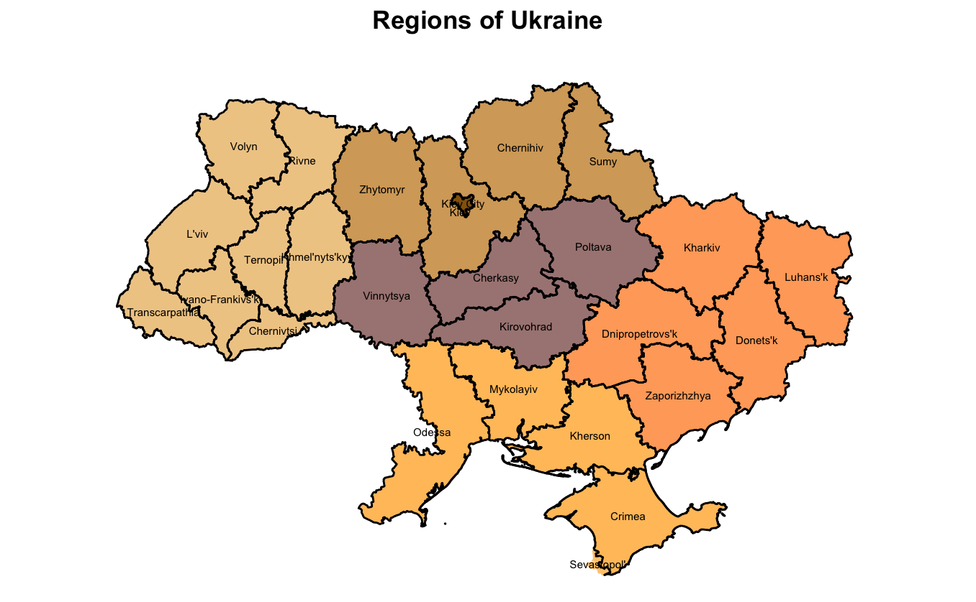

Slide 6
Apparent War Crimes in Northern Ukraine

Slide 7
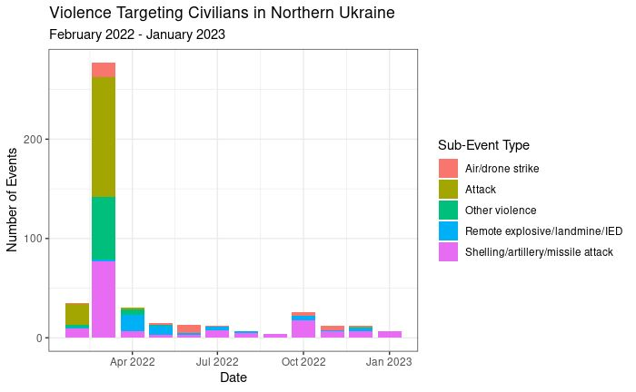

Slide 8
Heavy Fighting Along the Frontline in Eastern Ukraine

Slide 9
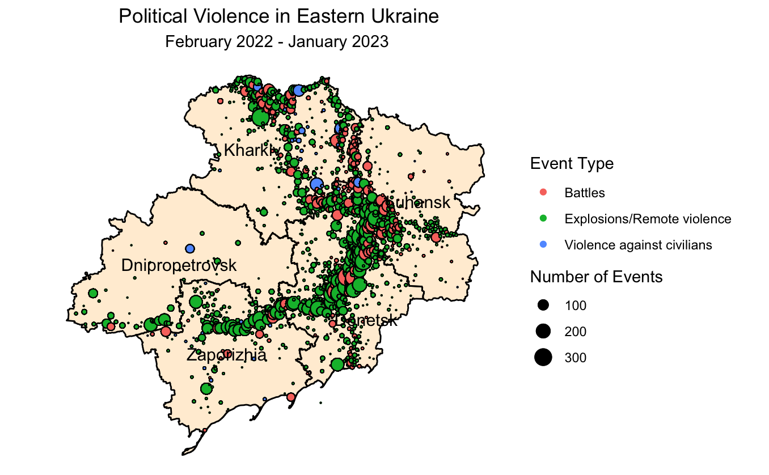
Eastern Ukraine faces unprecedented violence, with three-quarters of political violence events occurring in the region, primarily due to shelling, artillery, and missile attacks.
Despite relative distance from the frontline, the Dnipropetrovsk region remains at risk, as Russia continues air and missile strikes, exemplified by the deadly incident in Dnipro on 14 January 2023.
Notes:
Zeynep

Slide 10
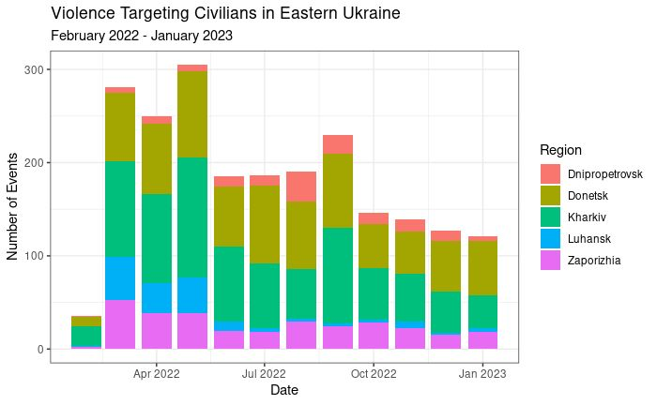

Slide 11
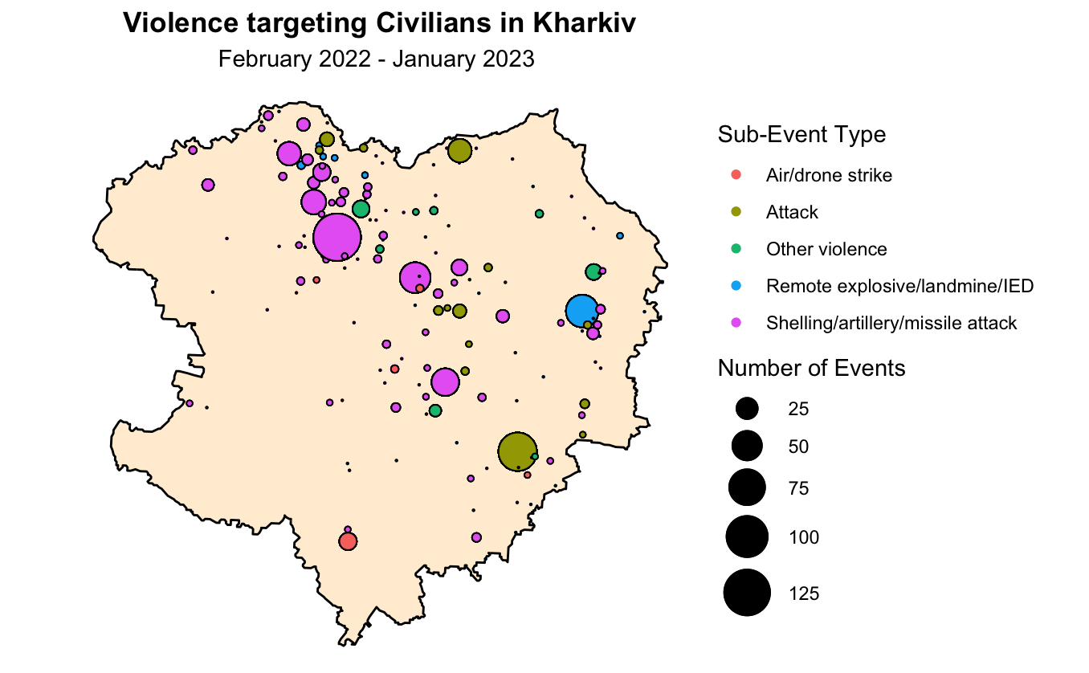
Although Russian forces were unable to break Ukrainian defenses around the city of Kharkiv, they had occupied the bulk of the region’s northern and eastern parts by April 2022, including Izium – a critical transport hub
Ukraine liberated almost the entire region in a surprise counter-offensive in September 2022.
Of over 800 events targeting civilians, about three-quarters constituted artillery, missile, and airstrike events, which also resulted in the majority of reported civilian fatalities recorded in the region. About a third of these occurred in March 2022 alone.

Slide 12
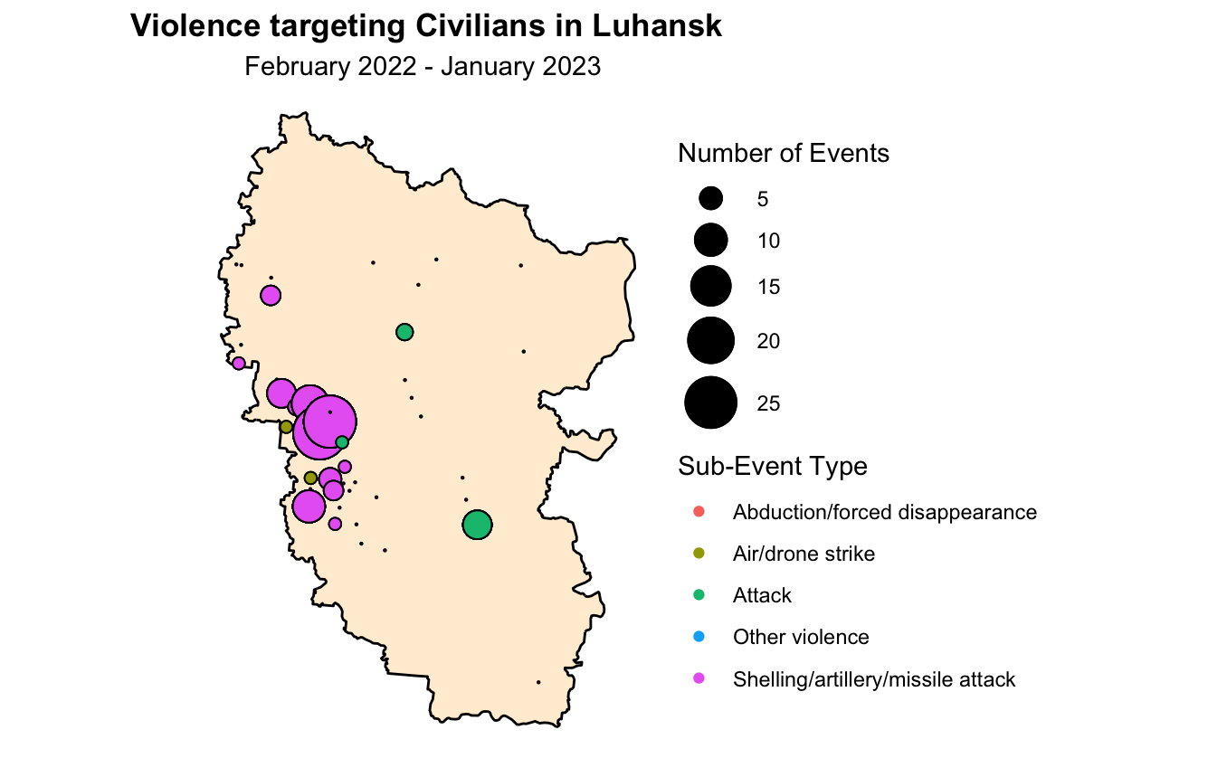
The sheer scale of artillery, missile, and air attacks inflicted on Luhansk region as well as intense close combat brought about immense suffering for the civilians.
On 11 March 2022, 56 elderly patients reportedly died during the shelling of a nursing home in Kreminna, and at least 60 people were killed in an airstrike on a school used as a shelter in Bilohorivka on 7 May 2022. Over 50 civilians were also killed during the shelling of Severodonetsk in March and May 2022.
Following the Russian occupation of the region in summer 2022, the number of reports of civilians being targeted went sharply down; though the region has remained highly kinetic, especially since autumn.

Slide 13
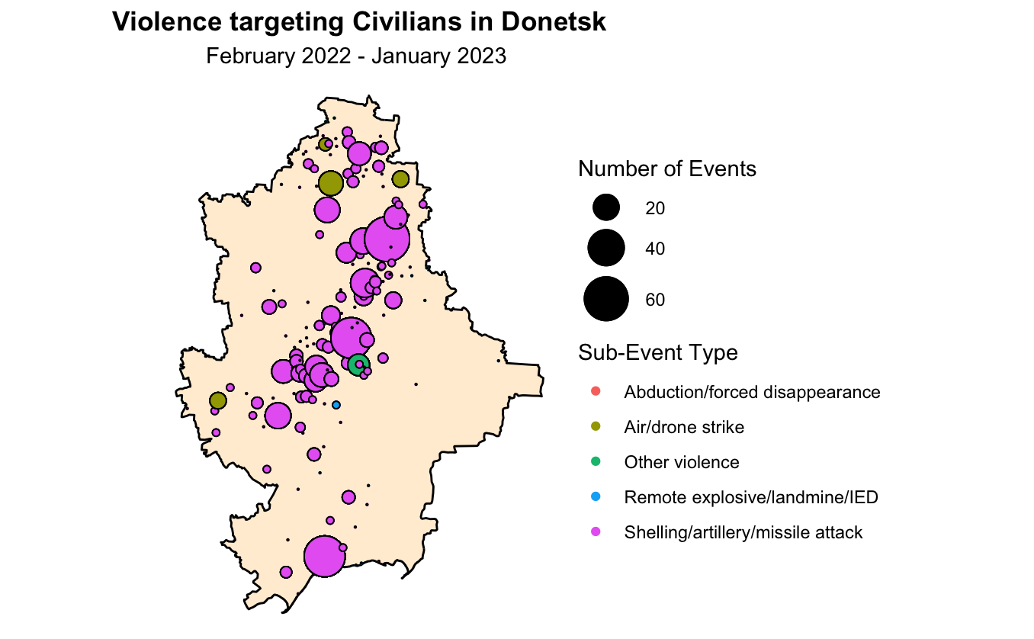
ACLED records over 16,000 events in Donetsk region, of which over 12,000 were attributed to shelling, artillery, missile, and airstrike events. Only a small portion of these events – about 800 – could be attributed to the direct targeting of civilian.
The city of Mariupol was the site of several mass casualty events ahead of the Russian occupation.
Mass casualty events due to long-range missile and artillery strikes occurred in other parts of the region and on both sides of the line of contact.

Slide 14
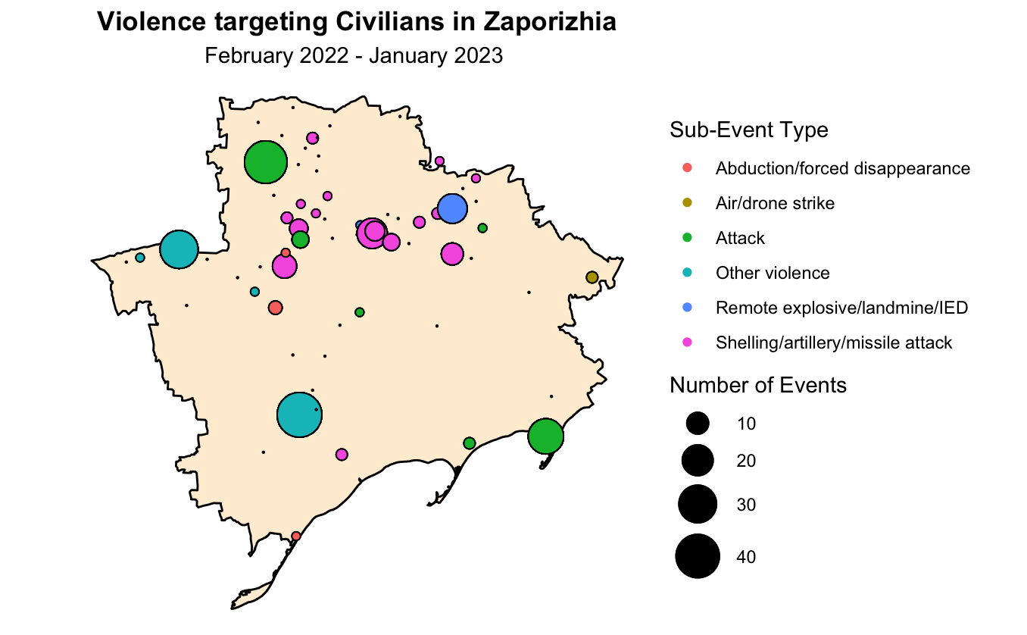
Russian forces occupied most of the Zaporizhia region in the first weeks of the invasion, capturing the entire shore of the Sea of Azov, including the Ukrainian navy base in Berdiansk, and an area stretching between the Kherson and southern Donetsk regions up to the Dnipro river, including the second-largest town of Melitopol.
Ukrainian forces stopped Russian forces in the area of Orikhiv and Huliaipole
Although shelling and air and drone strikes have accounted for about half of events targeting civilians in the Zaporizhia region, civilians have also been the subject of direct attacks. These include firing at vehicles carrying evacuating civilians, as well as torture and execution.
In areas under Russian occupation, reports of the abduction of local officials, teachers, journalists, Ukrainian army veterans, and civil activists are common.

Slide 15
Explosive Threats for
Civilians in Southern Ukraine

Slide 16
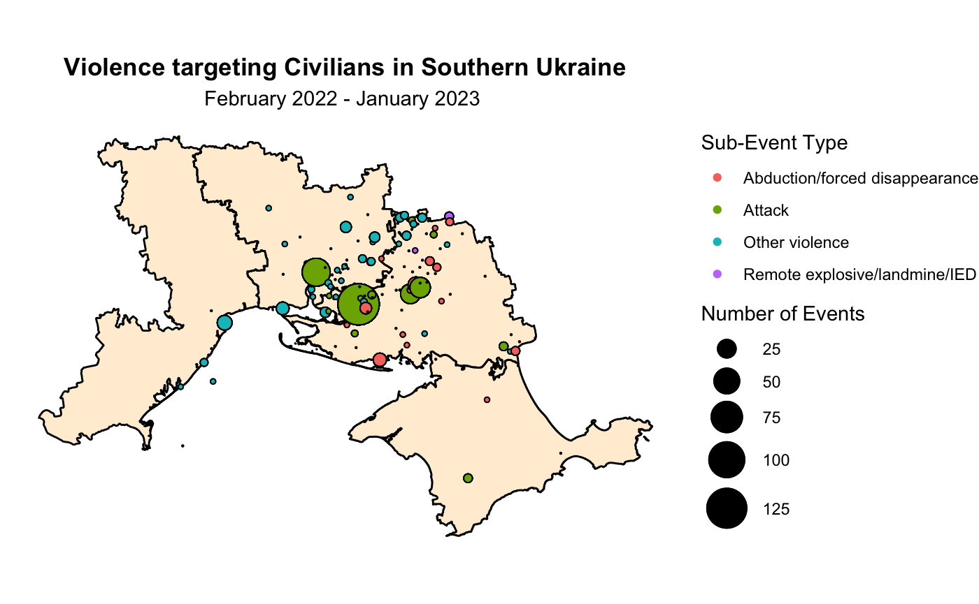
Russian attempts for landings from the Black Sea were unsuccessful.
Russian forces invaded southern Ukraine from the annexed Crimean peninsula, successfully overtaking the Kherson region and its main city in March 2022.
The Kherson and Mykolaiv regions experienced significant violence, with artillery strikes leading to high fatality numbers.
The most common types of violence in Kherson were abductions, forced disappearances, torture, targeting primarily officials, journalists, activists, and those suspected of pro-Ukrainian views.
In June 2022, Russian forces reportedly abducted about 50 Crimean Tatars from Kherson.
Two significant incidents in the Odesa region include a missile strike that killed 8 and injured 10 civilians on April 2022, and an airstrike that killed at least 21 civilians on July 2022.

Slide 17
Constant Menace from the Skies
in Central and Western Ukraine

Slide 18
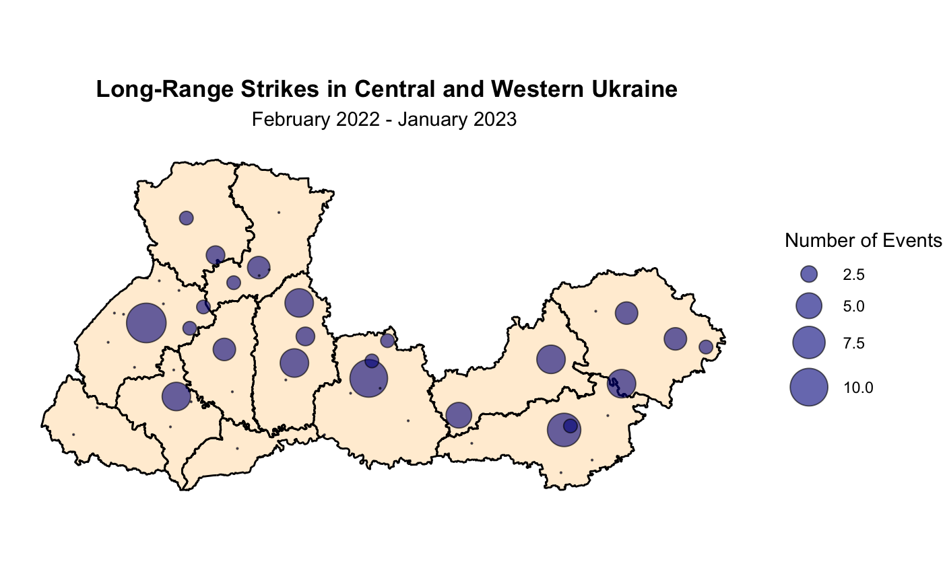
Over 150 Russian missile, air, and drone strikes have targeted the Central and West regions, posing a significant threat to civilian safety.
Approximately one-fifth of these strikes hit civilian areas, leading to over 80 fatalities.
Two incidents accounted for most of the reported fatalities: a missile strike on a shopping mall, in Poltava, on June 2022, and a missile strike on a Vinnytsia concert hall on July 2022.
At least 50 Russian strikes targeted energy infrastructure deep within Ukraine which caused power outages, with Vinnytsia being one of the most affected regions.

Slide 19
Conclusion of One Year War
The war in Ukraine has disrupted normal life and defied expectations of a quick subjugation.
Russian aggression has subjected millions of Ukrainians to violence and hardship.
Mass graves indicate potential atrocities in areas under Russian occupation.
Contamination of formerly occupied areas with mines poses a serious risk to returning civilians.
The war has led to a contraction of Ukraine's economy and internal and external displacement of millions.
Remaining civilians face ongoing disruptions to utilities and constant threats of cross-border strikes and shelling.
Russia's occupation of a nuclear power plant and nuclear weapon threats pose continuous risks to life and the environment in Ukraine and the region.
Notes:
The direct impact of the war on civilians extends far beyond those killed or injured. One year into the war, Ukraine’s economy has contracted by about a third and requires continuous external support.19 Over five million Ukrainians are internally displaced.20 About eight million people have been forced to seek refuge outside the country, of whom close to three million have found themselves in Russia,21 many having been ‘evacuated’ by the Russian forces against their will, including thousands of children.

Slide 20
Extended Analysis
Pre-Invasion Ukraine(2018-2022)

Slide 21
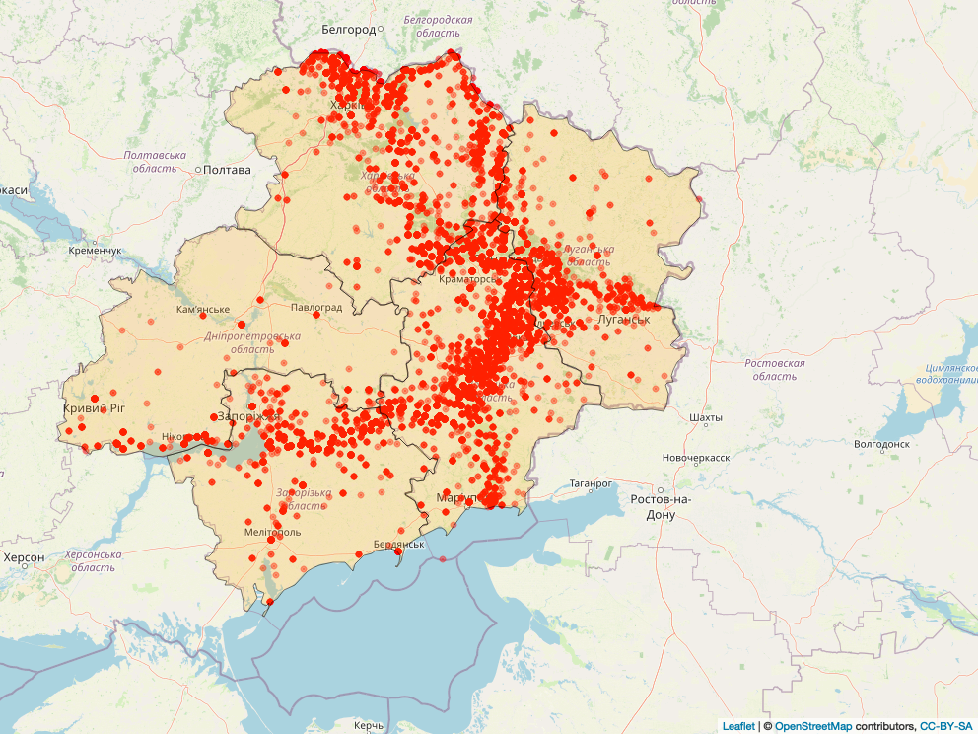
Heavy Fighting Along the Frontline in Eastern Ukraine

Slide 22
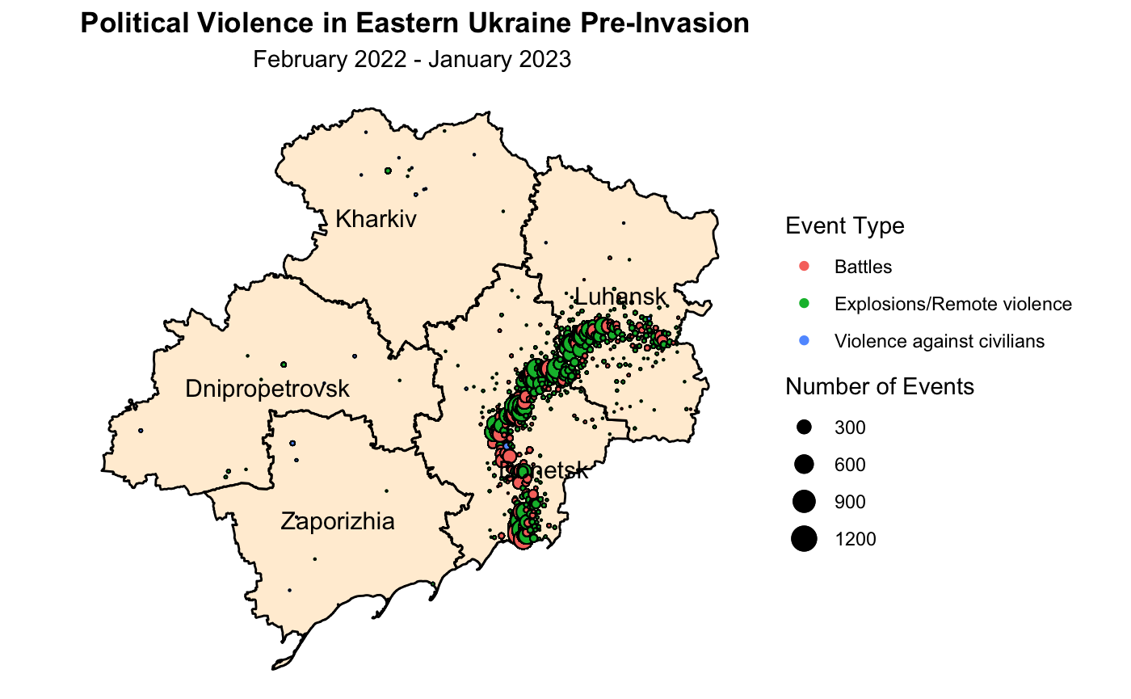

Slide 23
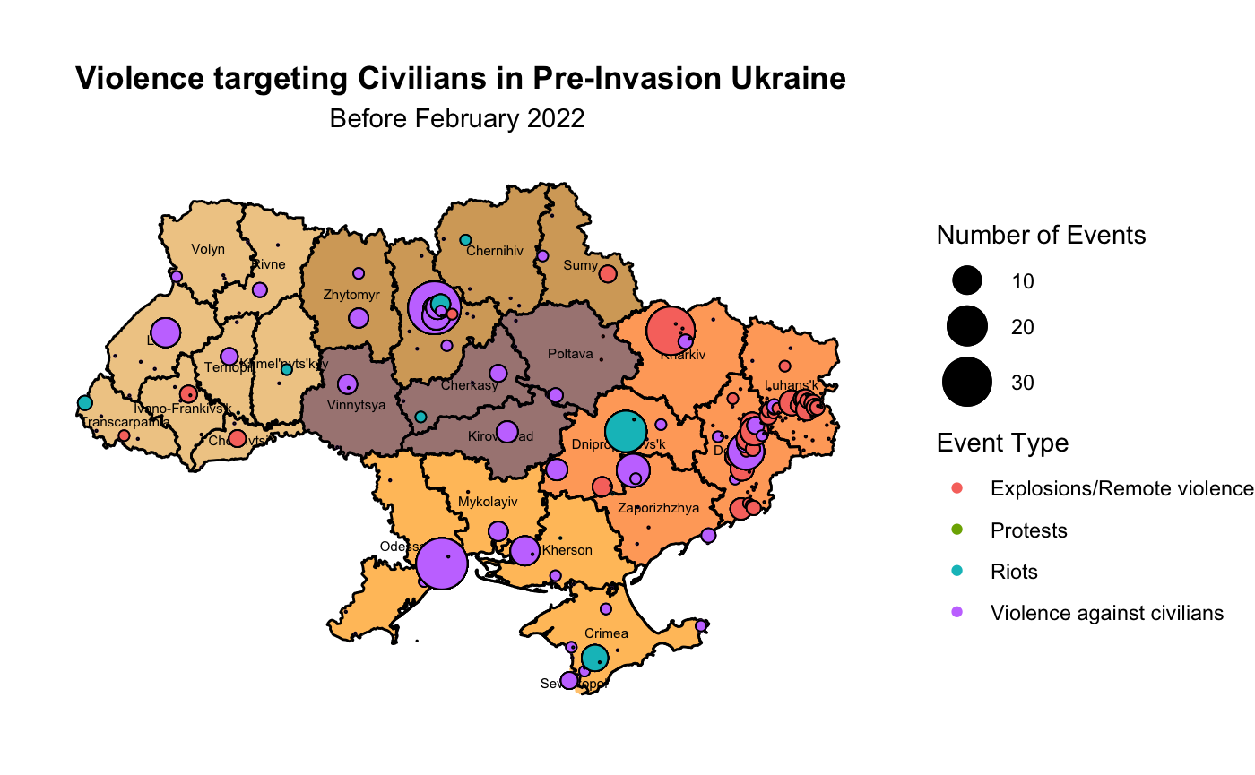
Pre-Invasion Violence Targeting Civilians

Slide 24
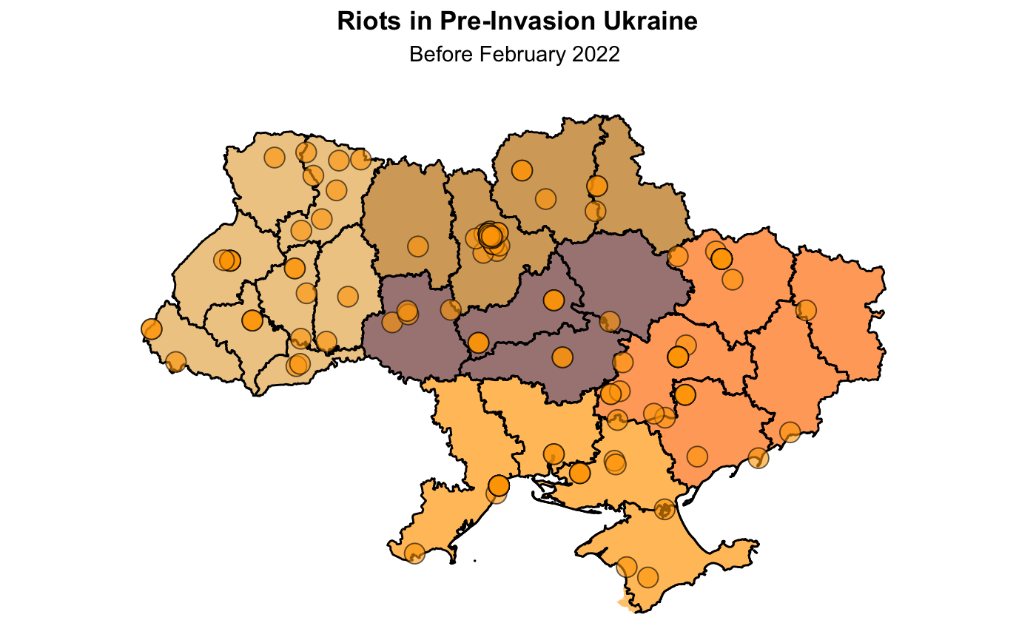

Slide 25
Literature Review

Slide 26
“Near-Real Time Analysis of War and Economic Activity during Russia’s Invasion of Ukraine”
Yuri M. Zhukov; Department of Political Science University of Michigan
This paper introduces new near-real time data on Russia’s full-scale invasion of Ukraine, and uses these data to investigate the short-term impact of occupation and violence on local economic activity.
Using remote sensing data on nighttime luminosity and remote sensing data on vegetation, a significant decline was found in economic activity in locations most exposed to combat.
t is estimated that urban areas that spent a month under contestation but neither combatant had full control, saw a 50% point drop in nighttime luminosity the following month.
Also, a decline was found in vegetation on agricultural land in actively contested areas. However, in areas fully under Russian occupation, an increase was found in both luminosity and vegetation.

Slide 27
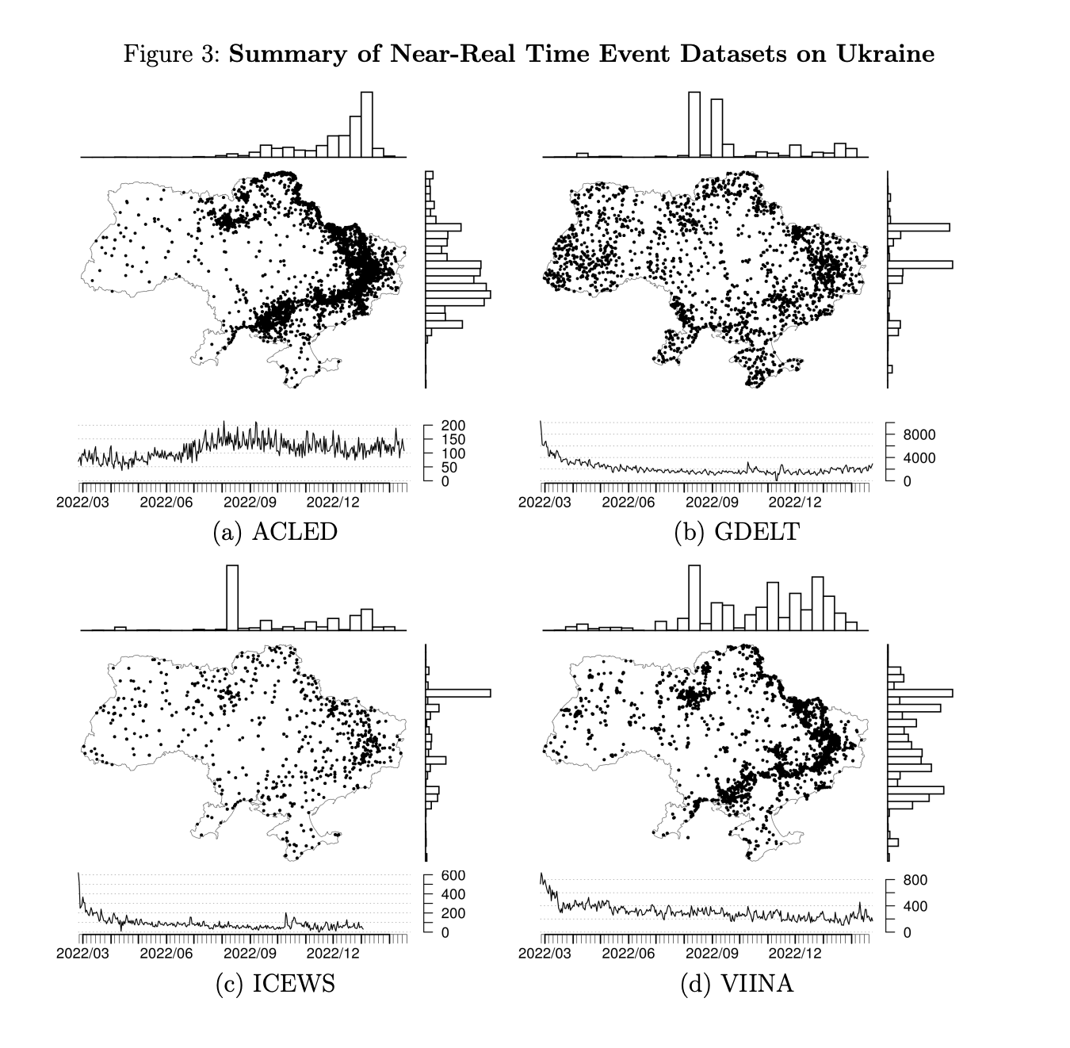

Slide 28
“Quantifying war-induced crop losses in Ukraine in near real time to strengthen local and global food security”
By Klaus Deininger , Daniel Ayalew Ali, , Nataliia Kussul, Andrii Shelestov, Guido Lemoine, Hanna Yailimova
A 4-year panel (2019–2022) of 10,125 village councils in Ukraine is used in this study to estimate effects of the war started by Russia on area and expected yield of winter crops aggregated up from the field level.
Satellite imagery is used to provide information on direct damage to agricultural fields.
Although data is currently only available for winter crops, results point towards a reduction of up to 4.84 million tons of wheat.
Taking area and yield reduction together suggests a war-induced loss of winter wheat output of up to 17% assuming the 2022 winter wheat crop was fully harvested.

Slide 29
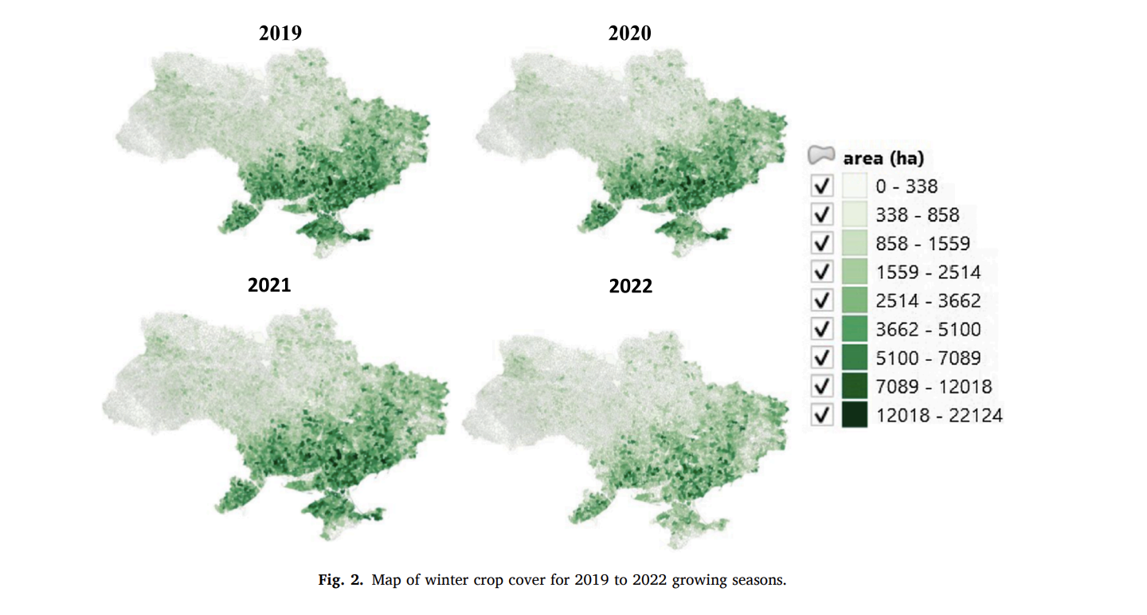

Slide 30
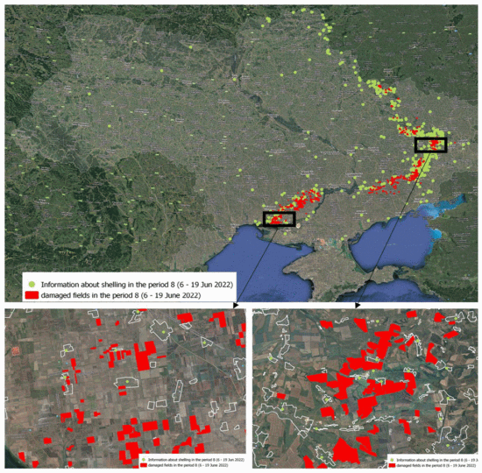
“Detection of War-Damaged Agricultural Fields of Ukraine Based on Vegetation Indices Using Sentinel-2 Data”
In this work, the search for war-damaged agricultural fields is based on data from the Sentinel-2 satellite. Cloud-free composites of Normalized Difference Vegetation Index (NDVI) are compared for the immediate period before and after active hostilities in a specific area (dates and locations obtained from ACLED source).
According to the results of research, such damage to agricultural fields as funnels from explosions and shelling, traces of machinery, burnt fields, etc., were found. Detected damaged areas were verified using ACLED data.
This data will provide an opportunity for the government of Ukraine and world representatives to correctly distribute financial resources among the affected landowners for the successful and effective restoration of the agricultural and industrial complex of Ukraine.
Geospatial location of identified damaged fields relative to official claims of military strikes (June 6–19, 2022).

Slide 31
Literature References
ACLED. (2023, March 1). War in Ukraine: One Year On, Nowhere Safe. Retrieved from https://acleddata.com/2023/03/01/war-in-ukraine-one-year-on-nowhere-safe/#s1
Association for the Study of Medical Education and John Wiley & Sons Ltd, “Fate and future of the medical students in Ukraine: A silently bubbling educational crisis” Med Educ. 2022 Aug; 56(8): 779–782. Published online 2022 May 18. doi: 10.1111/medu.14818
K. Deininger, D. Ayalew Ali, N. Kussul, A. Shelestov, G. Lemoine, H. Yailimova,”Quantifying war-induced crop losses in Ukraine in near real time to strengthen local and global food security” Food Policy,Volume 115, 2023, 102418, ISSN 0306-9192, https://doi.org/10.1016/j.foodpol.2023.102418
N. Kussul, H. Yailymova and S. Drozd, "Detection of War-Damaged Agricultural Fields of Ukraine Based on Vegetation Indices Using Sentinel-2 Data," 2022 12th International Conference on Dependable Systems, Services and Technologies (DESSERT), Athens, Greece, 2022, pp. 1-5, doi: 10.1109/DESSERT58054.2022.10018739.
Yuri M. Zhukov, ”Near-Real Time Analysis of War and Economic Activity during Russia’s Invasion of Ukraine”, Department of Political Science University of Michigan, 2023. https://sites.lsa.umich.edu/zhukov/wp-content/uploads/sites/140/2023/02/viina_v02.pdf

Slide 32
Data References
ACLED. [2023]. Armed Conflict Location & Event Data Project. Retrieved from https://www.acleddata.com/
GADM. [2023]. GADM - Database of Global Administrative Areas. Retrieved from https://gadm.org/index.html

